Slide 2
Challenges and Choices across Two Categories of IT Consolidations
Dana Roode, Associate Vice Chancellor & CIO
Stephen D. Franklin, Director of Academic Outreach
University of California, Irvine
Dr. Bryson Payne, Dept. Chair of Computer Science & Former CIO
Steve McLeod, Associate CIO
University of North Georgia

Slide 3
Agenda
Challenges and Choices in IT Consolidation at UC-Irvine
  Overview of IT at UCI, challenges faced
  Strategy & approach, lessons learned
Building the Consolidated IT in a Multi-University Merger at UNG
  Overview of two IT organizations, challenges
  Strategy & approach, lessons learned
Interactive Q&A
  Twitter: Hashtag #ITConsolidation
1
Notes:
Bryce

Slide 4
IT Consolidation at UC-Irvine
Overview of IT at UCI
Challenges faced
Strategy and approach
Lessons learned/reinforced
2
Notes:
UCI-Steve

Slide 5
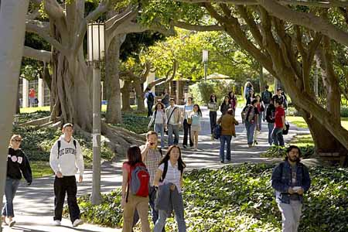
University of California, Irvine
Founded 1965, First among US universities younger than 50 years old
One of 10 campuses of the University of California
Distributed administrative structure
22,216 Undergraduates (Fall 2012)
5,263 Graduate/Professional Students (Fall 2012)
1,656 FTE Teaching Faculty
7,449 FTE Non-student employees on campus +
4,043 at Medical Center
3
Notes:
UCI-Steve

Slide 6
IT @ UCI, January 2009
Existing IT Units
  Administrative Computing Services
  Network & Academic Computing Services
  ~16 smaller IT groups in administrative units
  Libraries IT
  University Extension
  IT groups within academic units
  Health Systems IT
“Big Ideas” IT Workgroup
  Administratively Combine/Consolidate 1-3
  Consolidate “commodity” IT services
4
Notes:
UCI-Steve

Slide 7
IT @ UCI, July 2009
Provost creates Office of Information Technology (OIT)
  Initially:
    Administrative Computing Services
    Network & Academic Computing Services
    Other Administrative IT Units:
      Academic Affairs
      Graduate Division
      Office of Research
  Over time: …
  Not on the horizon: Health Sciences
5
Notes:
UCI-Dana

Slide 8
UCI Consolidation Goals
0. Not immediate new cost savings
1. Maintain service despite staff attrition
2. Improve efficiency, reduce duplication of effort
3. Campus-wide view of needs & priorities
4. Long-term savings through 1-3 and avoiding future costs
6
Notes:
UCI-Dana

Slide 9
UCI Challenges
Campus Expectations
  Service Levels
  Major Projects
  Diversity
  Immediate operational demands v. major project work
  Appropriate contacts at multiple levels to learn/monitor
  and to help shape/inform campus expectations
  Important Unmet client needs and
  Unmet Important client needs
  “Doing more with the same or less”
  becoming just “Doing less.”
Technology, Business, & Social Changes
  Cloud, BYOD, MOOCs, …
  Institutional v. Individual
7
Notes:
UCI-Steve

Slide 10
UCI Challenges (continued)
Staffing
  Changing roles
  Retirements, leaves & other departures
  IT professionals v. IT-savvy unit staff
  Equity within the organization, campus, “industry”
  Culture/Perspective/Orientation
    Administrative, Academic, Area-specific
    Client, Development, Service
“Perfect Storm”
8
Notes:
UCI-Dana

Slide 11
UCI Strategy & Approach
Maintain focus on goals
Collaboratively developed plans for each area
Incremental organizational changes
Integrate commodity services
Promote talent from within
Fill skill gaps from outside
Be flexible
9
Notes:
UCI-Dana
Maintain focus on goals
Collaboratively developed plans for each area
Incremental organizational changes
Integrate commodity services
Promote talent from within
Fill skill gaps from outside
Be flexible

Slide 12
UCI Lessons Learned/Reinforced
Culture Eats Strategy
Listen, discuss, think, listen, decide
Communicate directly
Learn from mistakes and be candid about them
Look for partnerships, but don’t depend on finding them
Leaving is harder than starting
Working with what you have can be better than working/waiting to get what you “need”/want
Institutional Support is Critical
10
Notes:
UCI-Dana & Steve

Slide 13
Multi-University IT Consolidation
Overview of IT at North Georgia & Gainesville State
Challenges faced
Strategy and approach
Lessons learned (things we wish we’d known…)
11
Notes:
UNG

Slide 14
IT @ North Georgia College & St.
34 FT staff, 20+ student and part-time [& 7,000 users]
4 divisions: Infrastructure, Engineering, Svcs, & Security
Prof Development: 10 Master’s degrees, over 80 IT certifications among 34 staff
Capability Maturity Model-aware, ITIL processes in place, CoBIT/NIST information security framework
$4M annual budgets
Completed Org Structure consulting with NDMA, Inc.
12
Notes:
UNG

Slide 15
IT @ Gainesville State College
25 FT staff, 20 student and part-time [& 9,000 users]
Less Prof. Dev: 3 Master’s degrees, <10 IT certs
Ad-hoc & manual processes (no ticketing system or help desk, IT staff situated in each building on campus, no desktop config mgt, few documented policies/proc.)
Some advanced apps: Virtual computer labs, portal
Ad-hoc budget – most technology funded end-of-year
Organic, decentralized structure, but very passionate, mostly younger staff
13
Notes:
UNG

Slide 16
Challenges for IT at the new UNG
Highly contrasting IT cultures (manual/ad-hoc v. ITIL/CMM)
Institutional culture differences - examples: campus communications, budgeting
CIO of more ITIL culture returned to faculty midway
Significant turnover following consolidation announcement (Sr. DBA, Sr. SysAdm, Inst Tech team, Sys Eng, 2 Net Eng, Infrastructure Mgr, CISO; Web Admin) - >30% turnover at one campus vs. <3% annual turnover past 6 years
14
Notes:
UNG-old

Slide 17
Challenges for IT at the new UNG
Scope change due to size increase (four campuses, twice the customer base) - Amplified the impact of changes to the IT systems environment, and amount of unplanned work
We now had TWO sets of "the way we used to do it"s...
Two biggest challenges:
  Timeline – Governor and Chancellor gave us 11.6 months to consolidate 16,000 students, 2000 emp.
  Leadership – 30+ committees/workgroups of 10-30 (or more) members, very little coordination/comm.
15
Notes:
UNG-new

Slide 18
UNG Strategy & Approach
Consolidation announced by Governor in January 2012
Deadline: January 2013
Kickoff meeting with all 59 IT staff, February 16, 2012
Informal dinner, planned seating, matching teams
One of the most helpful initial experiences was the “Post-it” note exercise a-la Theresa Wise, Delta CIO
16
Notes:
UNG

Slide 19
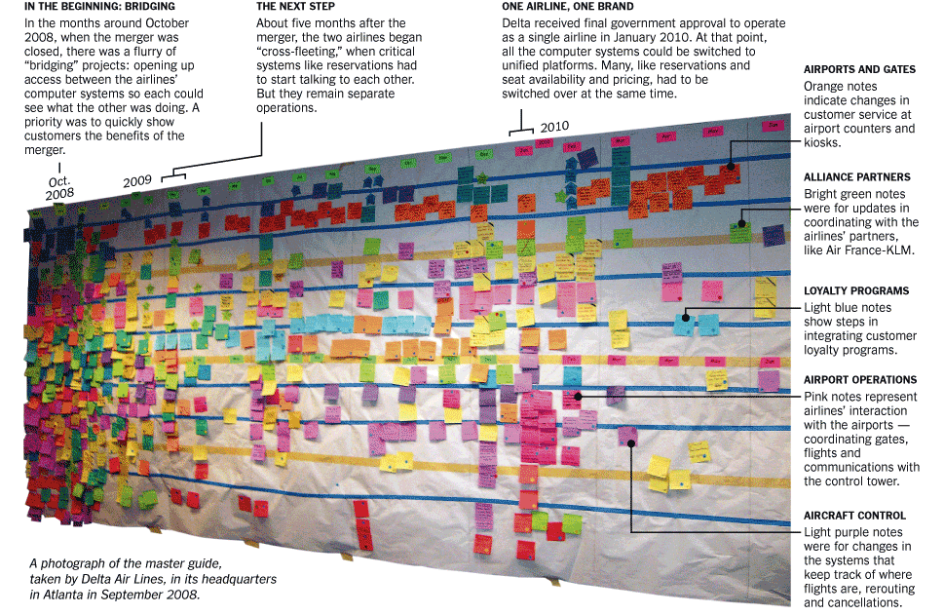
Strategy & Approach
Consolidation announced by Governor in January 2012
Deadline: January 2013
Kickoff meeting with all 59 IT staff, February 16, 2012
“Post-it” exercise a-la Theresa Wise (Delta CIO)
17
Notes:
UNG

Slide 20
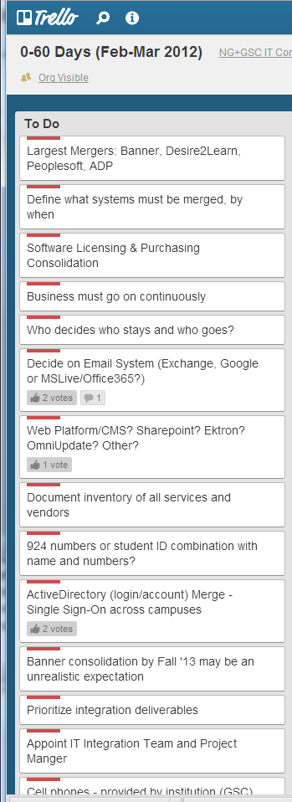
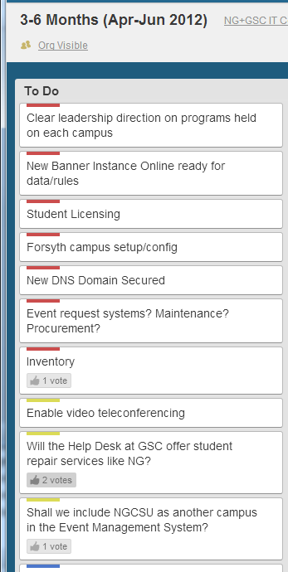
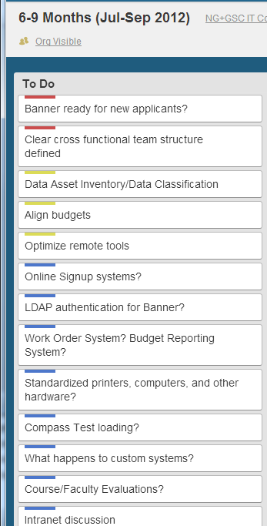
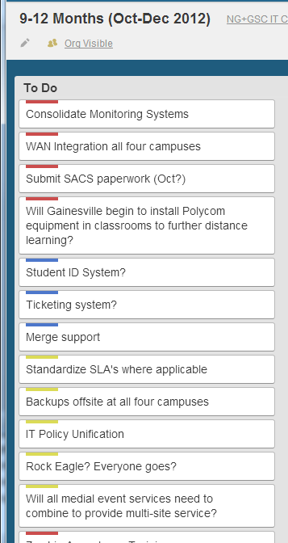
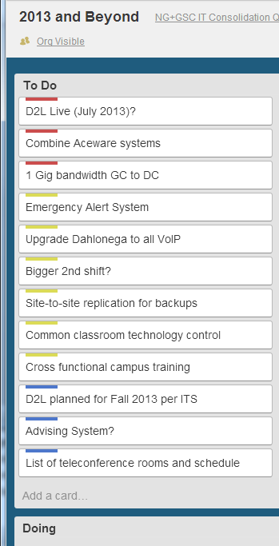
UNG Strategy & Approach (cont.)
Gathered pressing/urgent concerns and items for 0-60 days, 3-6 mo, 6-9 mo, 9-12, and 1yr and beyond
Used simple online note system (trello.com) to share
18
Notes:
UNG

Slide 21
UNG Strategy & Approach (cont.)
Gathered concerns up front, gave everyone a voice from front line to senior management – captured 150 systems /services (80% of the 180 eventual integrations)
Helped us keep an eye on critical path/timeline items
Goal was to make final IT structure & operations the “best” of each org’s strengths
Conflict came from deciding what was “best”
Having a clear (and externally imposed) deadline made delivery objectives clear (15 mos. to new Banner, etc.)
19
Notes:
UNG

Slide 22
Lessons Learned – UNG
Do team-building before digging into technical weeds
Leadership, including handoff planning, is critical
Needed to plan for higher turnover or resolve issues fast
Project management support and communication vital
Dedicated IT staff can cover for most tight deadlines, but burnout is a danger if no time off/relief planned ahead
Today, 20 months later, all critical IT systems are operational and consolidated
20
Notes:
UNG-old

Slide 23
Lessons Learned - UNG
Communications - an overarching communications plan needs to be in place early in the process.
Listen, listen, listen - then plan and do.
When culture and pride get in the way, form cross-functional teams and task them to come up with a new way that is better than either of the previous ways.
Realize that you've got new resources - people AND ideas - capitalize on “is there anything you already wanted to make better about the old way, but you never had the people to do it?”
21
Notes:
UNG-New

Slide 24
Tips for Both IT Consolidation Types
Planning for consolidation –
  Top-to-bottom strategic direction
  Bottom-to-top feedback methods
  Identify critical decisions/milestones early
Restructuring for consolidation –
  Rethink org structures – get consulting if needed
  Structure directly impacts service, culture
Implementation –
  Maintaining service & responsiveness
  Building and keeping unit cohesion
22
Notes:
UCI & UNG

Slide 25
Contact info
Twitter: #ITConsolidation
Dana.Roode@uci.edu
Bryson.Payne@ung.edu, twitter.com/brysonpayne
Slides: www.brysonpayne.com/EDUCAUSE2013
23
Notes:
UCI & UNG

